Slide 1
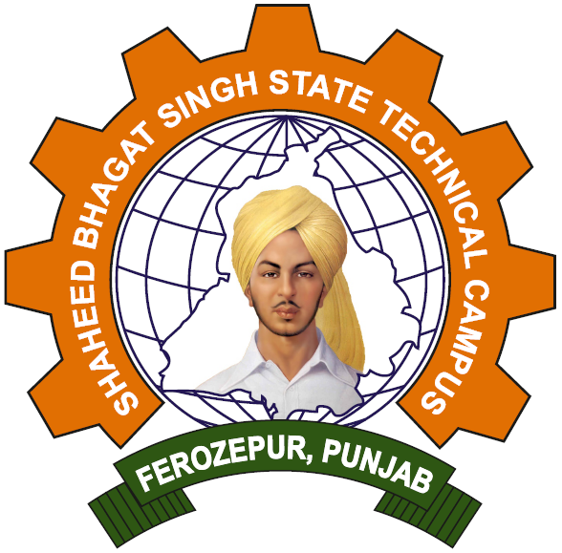
Shaheed Bhagat Singh State Technical Campus
MINOR PROJECT PRESENTATION

Slide 2
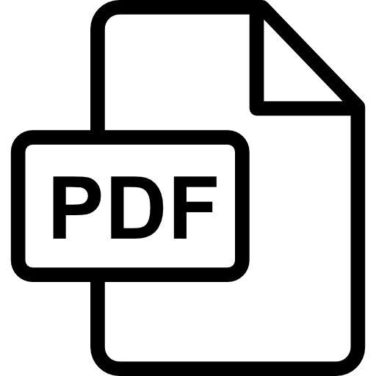
MINOR PROJECT - PDF CONVERTER
CONVERTER
AUTHORS:
AMIT KUMAR MANDAL
ABHIJEET GANGULY
AJAY KUMAR

Slide 3
Presentation Outline:
Introduction
Objectives
Technology used
Reason for choosing Python
Why PDF Converter
Methodology
Flow Diagram
Features
Screenshots of App
Strength of System
Evaluation
Future Work
Learning from Project

Slide 4
INTRODUCTION
PDF converter:
A pdf converter which processes IMG , WORD ,PPT, PDF files to give output as pdf file. Also have features like pdf files merging, reodering pages ,Image OCR, etc.
Few Features:
OCR reader: read words from images .
Image to PDF: convert multiple image sources in a single compiled PDF file for easy management and avoid loses.
Cropping(to reduce noise): It is a side feature of image to Pdf which gives the ability to remove unnecessary parts of image.

Slide 5
Objectives
Our objective is to design a solution for IMG to PDF conversion for academic purpose. Our major Goals for the project are:
IMGs to Pdf conversion
IMG to OCR
DOC to PDF (for Multiple files also)
PPT to PDF (for Multiple files also)
PDF Merger

Slide 6
Technology used:
Python
Computer vision
Office suit
Os module
VS code
Tkinter
Img2PDf
Pillow

Slide 7
Reason for choosing Python
We choose Python as we are new to desktop app development and Python provides very simple tools for this purpose.
Despite of that python has very interactive GUI Library.
Also Python provides a huge community support.

Slide 8
Why PDF converter?
As due to COVID-19 most of the institutions are taking exams online (open book). But we observed that most of the students are facing problems with this mode of exam conducting due to insufficient knowledge about pdf conversion , or the complex interface of already available pdf converters , the limited size of pages in pdf etc.
Also , Teachers(mostly school teachers) are tensed too by this problem . As it is completely new environment for them too.
So , we thought to provide a solution to this problem. As it’s a very common and widely observed problem.

Slide 9
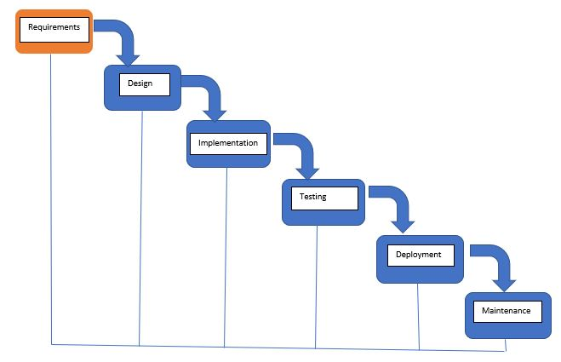
Methodology
We picked Waterfall Model as our Model for our project because waterfall model is very simple to implement and doesn’t require much experienced team. It is perfect for these small scale projects.
One milestone of waterfall is that it doesn’t require much effort to track process and to arrange tasks. We can easily document the process using this model.

Slide 10
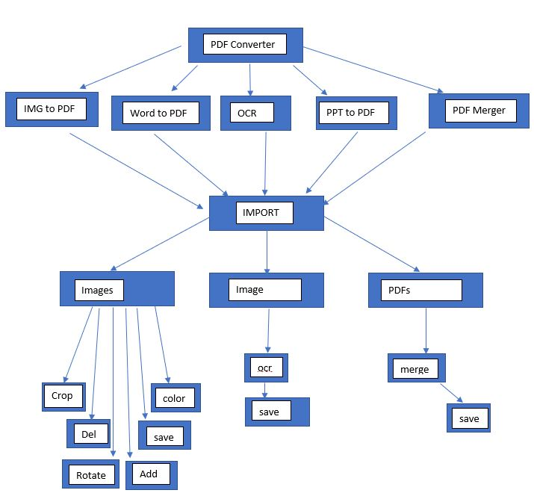
Flow diagram

Slide 11
Features
The app has various functions like cropping , color, delete, add file, import, save, rotate etc.
Crop function:
Crop code uses 2 libraries PIL(pillow) and cv2. Cv2 offers to select 4 points in image to crop out inscribed area by four points and then PIL performs image conversion from different forms and put back image in list.
Selection of 4 points is in Z format. Pressing S saves the image . Pressing E exits the CV2 viewport.
Prev Button(<<):
Previous Button is a feature to move between images And this particular button brings the previous image in viewer.
Next Button(>>):
Next Button is a feature to move between images And this particular button brings the next image in viewer.

Slide 12
Features (cont.)
Import Button:
Import button is used to import images and all other supported files from directory to our application.
Add Files:
Add Flies is used to add more images or all other supported files in application.
Color:
Color button provides effect to images to give more readable output.

Slide 13
Features (cont.)
Rotate:
Rotate Button is used to rotate a image. It is implemented as 90 degree counterclock-wise.
Save pdf/Convert:
This button saves the images imported in application in pdf format.
Delete :
This button provides the functionality of deleting the current image in viewer.

Slide 14
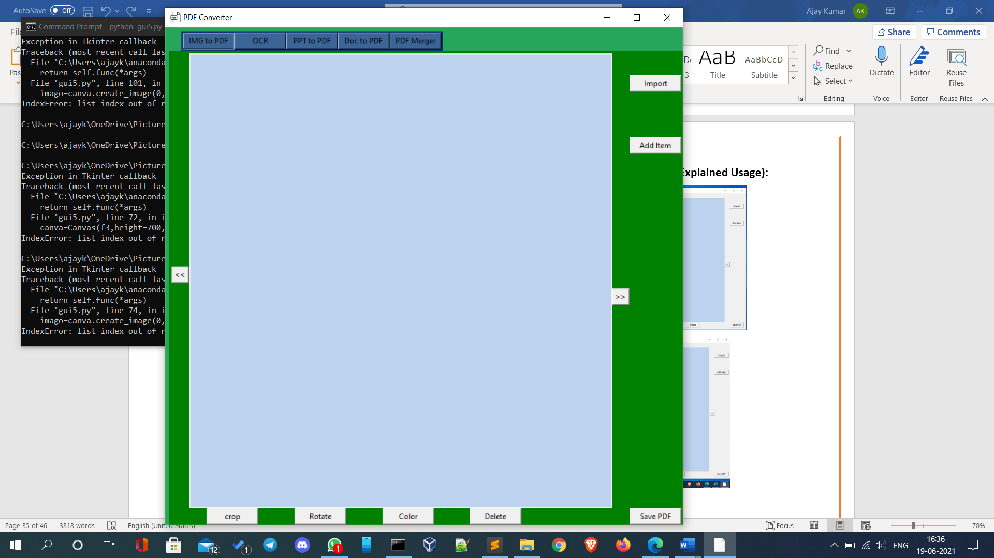
Screenshots of App
IMG to Pdf interface

Slide 15
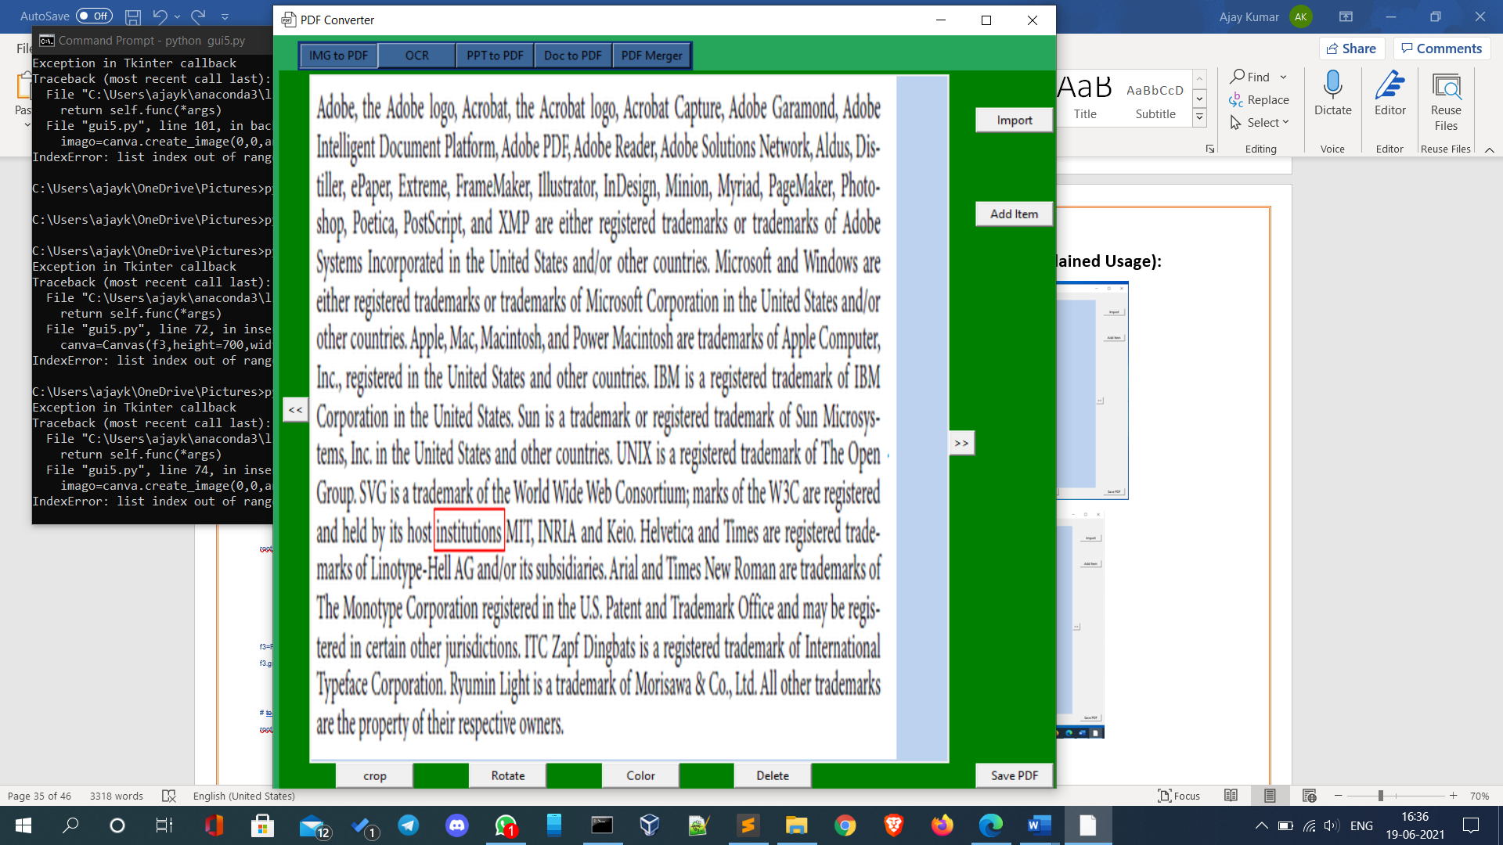
Screenshots of App
IMG to OCR interface

Slide 16
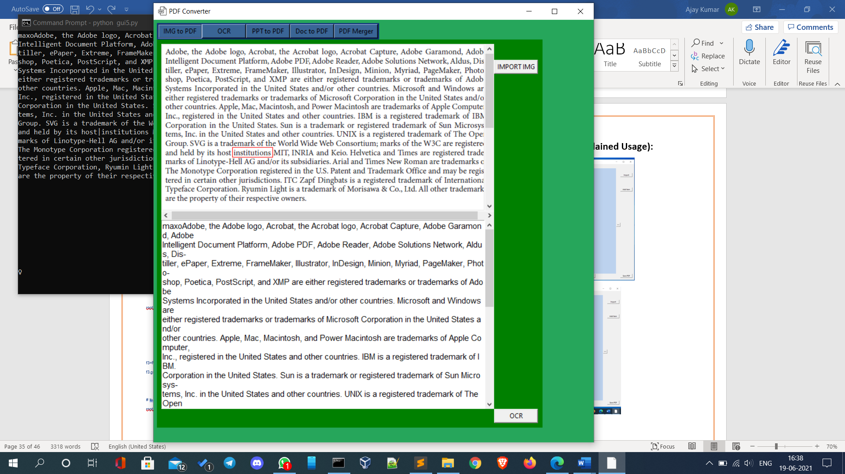
Screenshots of App
IMG to OCR implementation

Slide 17
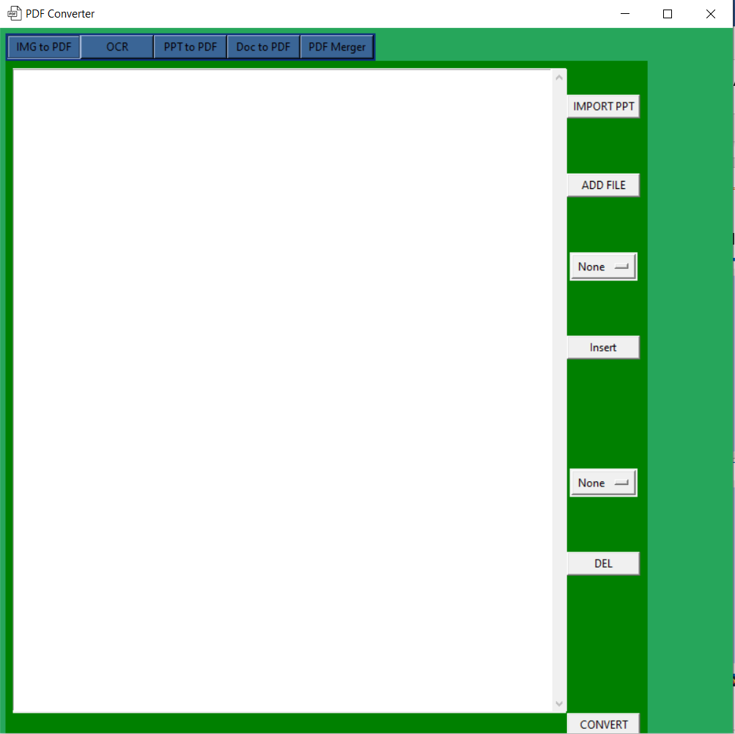
Screenshots of App
PPT to Pdf interface

Slide 18
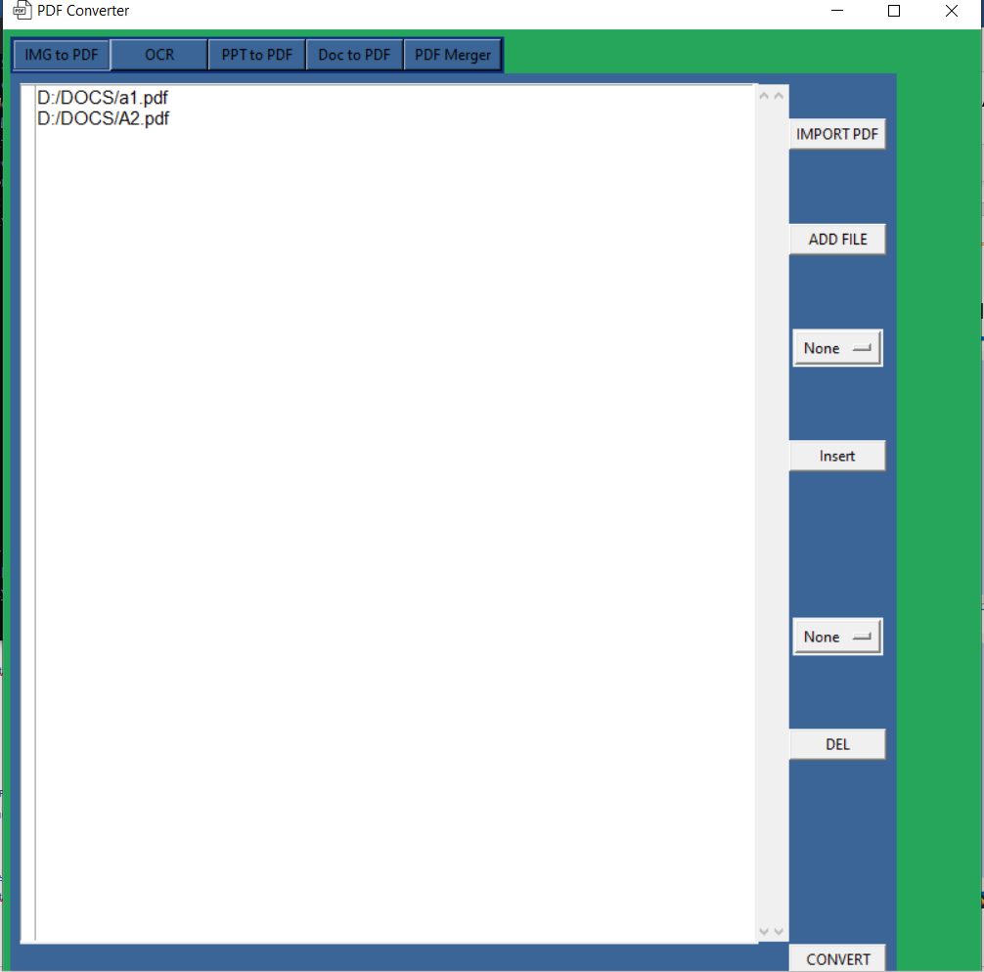
Screenshots of App
Pdf Merger interface

Slide 19
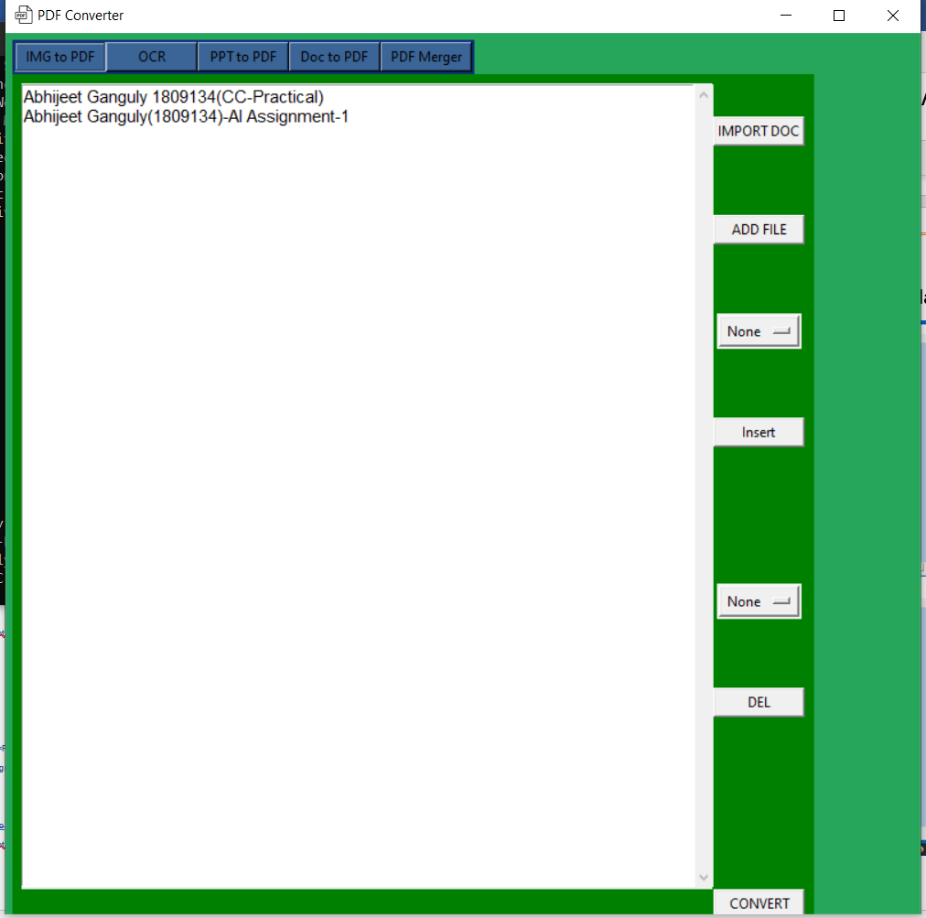
Screenshots of App
DOC to Pdf interface

Slide 20
Strength of system
No internet connection is required.
Process size of operating system is very low.
Multiple and repetitive task of Pdf Conversion can be automated.

Slide 21
Evaluation
There are some limitations in our application
1. Most of people doesn’t have pc.
2. Needs Images from other source.
3. Office suit is mandatory for working of this application
4. Few features are Windows Dependent

Slide 22
Future Work
Updates:
Our application is still under development. Below listed are the Goals for application.
Color Filters
PDF viewer
PDF Compressor
Future Goals:
From our Observation and Research we come to conclusion that Online Platform will be more efficient and easy for users. So we are moving toward a Website and a mobile application development so that everyone can easily use our services.
Mobile application development
Web App development

Slide 23
Learning from project
Desktop app development Fundamentals
Familiar with VS code(IDE)
Python library fundamentals
Use of tkinter
Use of computer vision library
Different techniques of debugging

Slide 24
Thank You for your time

